Slide 1
Data Model

Slide 2
MongoDB Concepts
Dealing with:
variety of document formats.
changing document structure using replaceOne()
the non-existence of JOIN operation.
Large volume
Index
Data Model selection

Slide 3
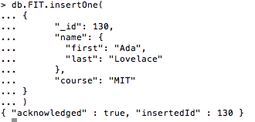
Variety of documents
A collection may contain documents with different structure.
Example: no results in the document below.
db.FIT.insertOne(
{ "_id": 130,
"name": {
"first": "Ada",
"last": "Lovelace”
},
"course": "MIT”
}
)
You can use update() to change document structure.

Slide 4
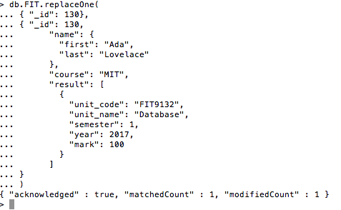
Changing the document structure
replaceOne().
Example.
db.FIT.replaceOne(
{"_id": 130},
{"_id": 130,
"name":
{
"first": "Ada",
"last": "Lovelace"
},
"course": "MIT"
"result": [
{"unit_code": "FIT9132",
"unit_name": "Database",
"semester": 1,
"year": 2017,
"mark": 100
}
]
}
)
filter

Slide 5
Modelling Document (1)
Model 1
{ results: [ {"item": "content", "score": 9}, {"item": "presentation", "score": 6}]}
db.evaluation.find({"results":{$elemMatch:{"score":9,"item":"presentation"}}})
Model 2
{results: {"content": 9,"presentation":6}}
db.evaluation_1.find({"results.content":9})
Model 3
{ results: [ {"content": 9}, {"presentation":6}]}
db.evaluation_1.find({"results.presentation":9})

Slide 6
Modelling Document (ii)
Treatment of NULL
In general, it is more common to omit the field or key.
Save space for very big data set (fitting into memory)
Use the $exists operator to check.
Beware of Array!

Slide 7
Modelling relationships in MongoDB
Redundancy may exist, data typically is not normalised.
Connecting two or more documents.
Embedding.
Referencing
There is no JOIN operator.
Join can be performed using:
$lookup in aggregate => outer join
Embedded document structure
Application code

Slide 8
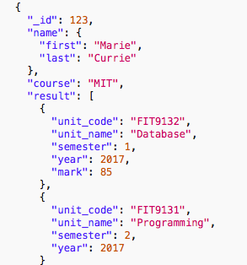
Embedding document
The UNIT information (unit_code, unit_name) is embedded in the STUDENT document.

Slide 9
JOIN using aggregation
db.FIT.aggregate(
[
{$lookup:
{ from: "unit",
localField: "result.unit_code",
foreignField: "_id",
as: "enrolled_unit”
}
},
{$out:"studUnit"}
]
)
Collection to be joined into the current collection
Join-key at current collection
Join-key at collection defined in “from”
Array name to keep the result of join operation in current collection

Slide 10
Referencing Child Document
db.unit.insertMany([
{"_id": "FIT9132",
"unit_name": "Database",
"synopsis" : "This is an introduction unit"},
{"_id": "FIT9131",
"unit_name": "Programming",
"synopsis" : "This is a Java programming"}
])
As an array of _id values
{ …
"year":2017,
"semester":1,
"offering":["FIT9132","FIT9131"]
}
Notes:
Think this as something similar to a bridging entity.

Slide 11
Combining referenced child document
db.offer.aggregate(
[
{$lookup:
{ from: "unit",
localField: "offers",
foreignField: "_id",
as: "offer_unit"}
},
{$project:{offers:0}}
]
)

Slide 12
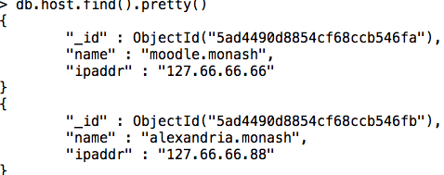
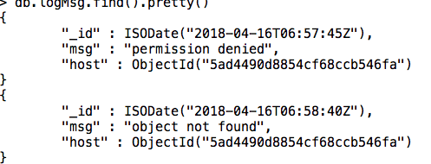
Referencing Parent Document
As a pair (key, value)
Notes:
Pair is needed because there are other information needs to be associated with the unit.

Slide 13
db.logMsg.aggregate(
[
{$lookup:
{from: "host",
localField: "host",
foreignField: "_id",
as: "host_msg" }
},
{$out:"host_msg"}
]
)

Slide 14
Modelling ONE-to-MANY
One to SOME
Embed the ”some” documents in the “one” document.
One to LARGE number of documents (eg thousands)
Use array to keep reference key of the many side. (child referencing)
Make sure array is not too big.
One to VERY LARGE number of documents (eg millions)
Keep the reference key as a pair of (key,value)
Keep the reference key of the one side in the many side (parent referencing)

Slide 15
Schema Modeling
https://www.mongodb.com/blog/post/6-rules-of-thumb-for-mongodb-schema-design-part-1
https://www.mongodb.com/blog/post/6-rules-of-thumb-for-mongodb-schema-design-part-2
https://www.mongodb.com/blog/post/6-rules-of-thumb-for-mongodb-schema-design-part-3

Slide 16
Design Considerations
There is no formal approach to the design.
NO normalisation (☺ or ☹)
Finding entities and relationships is still useful.
User requirements is more than just knowing the entity and relationships.
There is a need to understand access patterns.
Which data needs to be retrieved very fast? How often? How critical?
The read/write ratios.
Which data does not change often? i.e not many updates on this.
Server or client operations?
Server provides indexes, optimisation and parallelism.
Application may provide more efficient processing compared to the aggregation, eg using inner join at the application rather than outer join (aggregation in the server)

